Slide 1
Project 1
Group 3
Song Yi
Connie
Wei Hao
Mingzi

Slide 2
Agenda
Objective
Data Cleaning/ Merging
Initial observations on data
Analysis on target states
Analysis on subjects
Conclusion

Slide 3
Objective : We are a group of academia specialists, hired by institutions in the US to identify states with growth potential in private tuition to secure entry to College.
Target states
1) with the potential to increase SAT/ACT scores
2) by subjects to improve

Slide 4

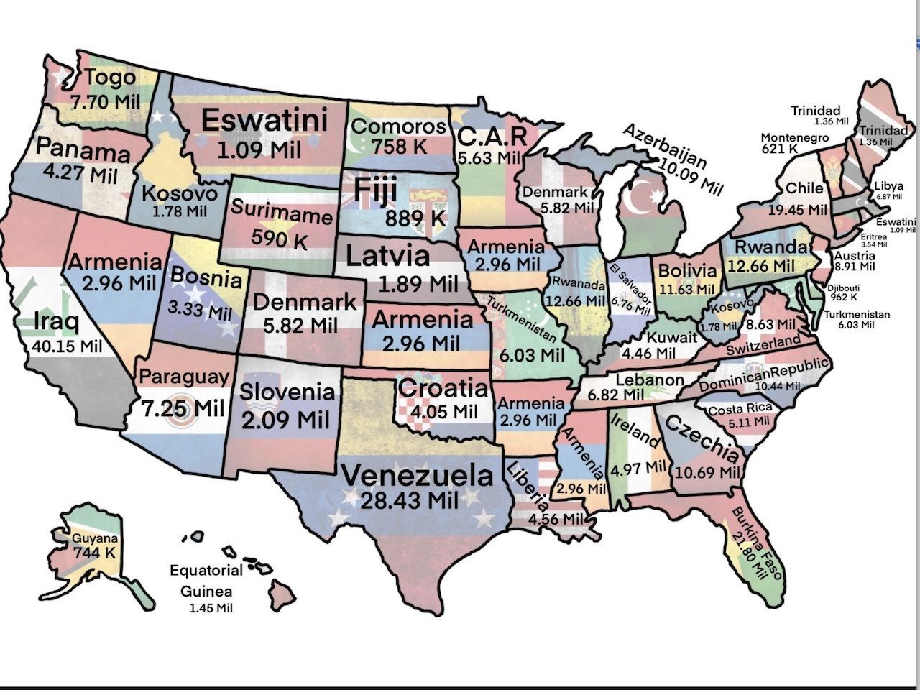
Brief methodology:
In addition to the existing data, we have complimented it with the below data from their respective sources
Trended GDP per capita by states - U.S. department of Commerce.
Population of each State - US Census Bureau

Slide 5
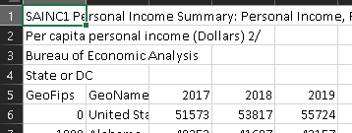
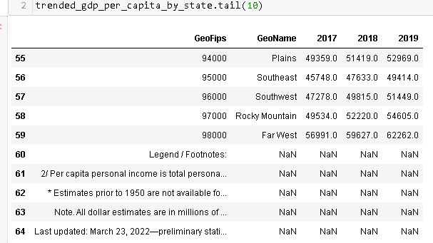
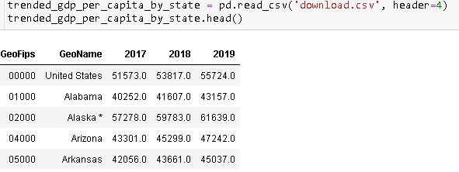
Data Cleansing
1
Some rows/ columns are redundant
2
External data source is not in dataframe format
Notes:
SY - Elaborate on Data Mergers
Elaborate on dropped States
Separating Merged file into Individual SAT/ACT File
Clean external data

Slide 6
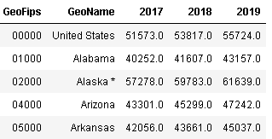
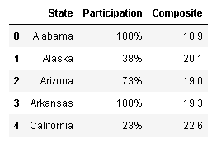
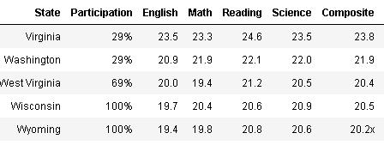
Data Cleansing
1
3
A few data points have special symbols, ‘!@#$%’ or string
Removal of ‘%’ symbol for column to be read as a float.
2
Notes:
SY - Elaborate on Data Mergers
Elaborate on dropped States
Separating Merged file into Individual SAT/ACT File
Clean external data

Slide 7
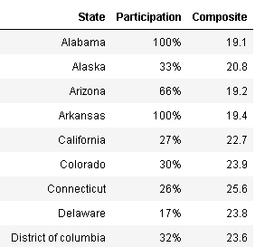
Data Cleansing
1
Some of Maryland’s subject scores do not tally with the Total/ Composite score.
2
A lower-case ‘c’ in ‘District of columbia’
cause this state to have null values during merger.
3

Slide 8
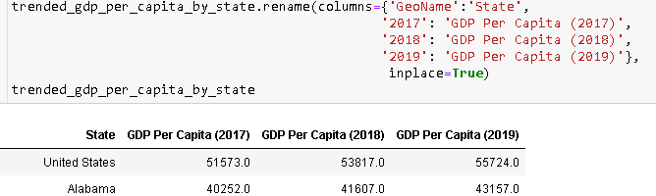
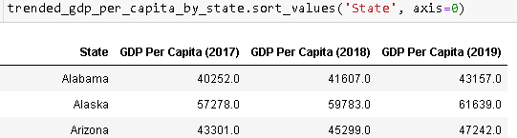
Data Cleansing
The next step is to rename the columns so that they are readable.
After renaming the columns of the dataframe, it was sorted in ascending alphabetical order
Notes:
SY - Elaborate on Data Mergers
Elaborate on dropped States
Separating Merged file into Individual SAT/ACT File
Clean external data

Slide 9
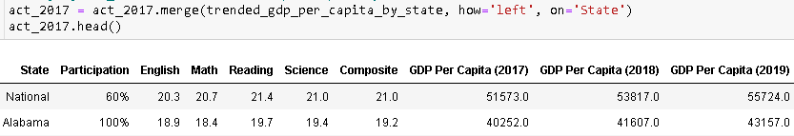
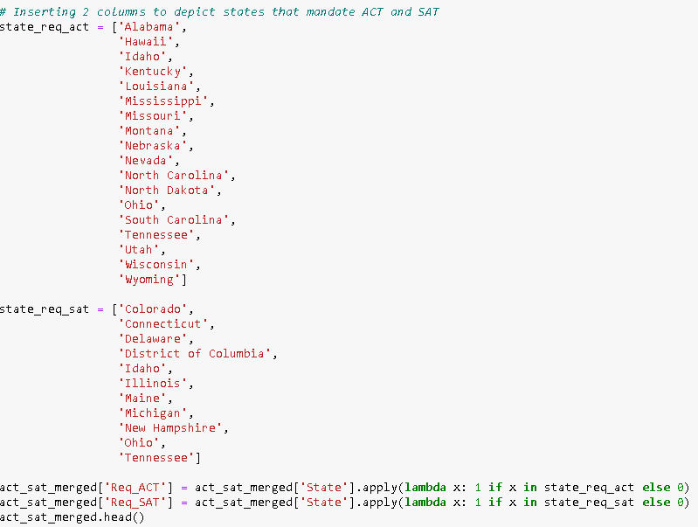
Data merger
With data cleaning done, we proceeded to merge all the data into 1 dataframe.
Having 1 consolidated dataframe, our group realised some states mandated ACT and others deem SAT compulsory.
Therefore we inserted 2 columns to depict these requirements.
Notes:
SY - Elaborate on Data Mergers
Elaborate on dropped States
Separating Merged file into Individual SAT/ACT File
Clean external data

Slide 10
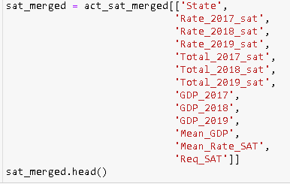

Data merger
With a consolidated dataframe, 2 new data frames were created with each containing solely ACT information and the other only data from SAT.
Notes:
SY - Elaborate on Data Mergers
Elaborate on dropped States
Separating Merged file into Individual SAT/ACT File
Clean external data

Slide 11
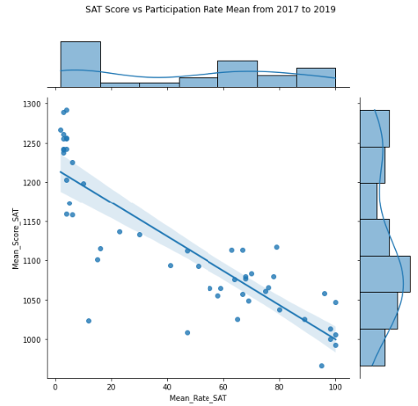
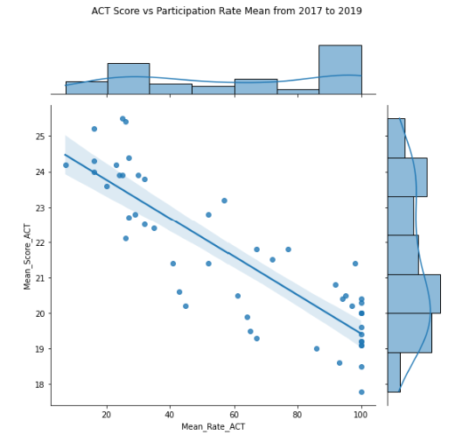
Correlation between average score and participation rate
Base on trended data for SAT and ACT, average scores and participation rates have an inverse relationship
Notes:
Average participation rate vs average participation score
the scores are inversely related to participation rate, this mean that when a state has a high score, there is low participation rate in that state.
The score does not have a good representation of the overall scores of the State as it has a low participation rate as compared to other states.

Slide 12
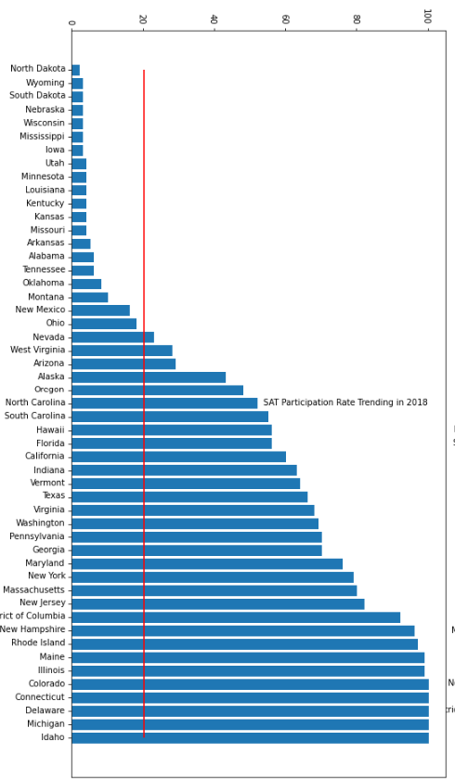
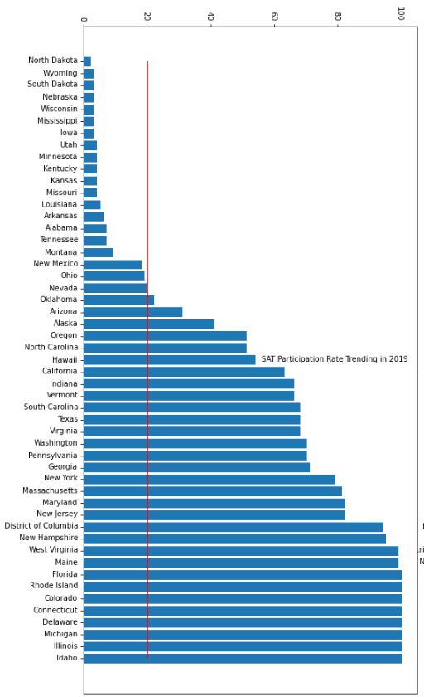
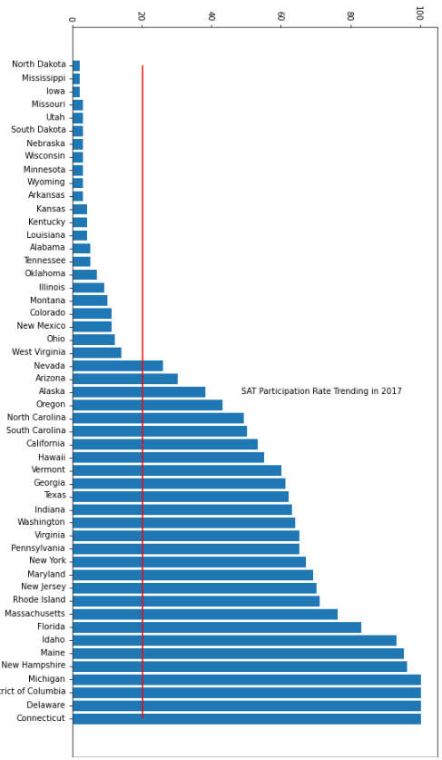
SAT Participation Rates from 2017 to 2019
20
19
23
Notes:
For our following analysis, we need to exclude the above mentioned states. To do this, we look at clustering. After plotting the bar charts reflecting SAT participation rates, 23, 20 and 19 states have participation rates lower than 20% in 2017, 2018 and 2019 respectively, and we have excluded these states for our further analysis below.

Slide 13
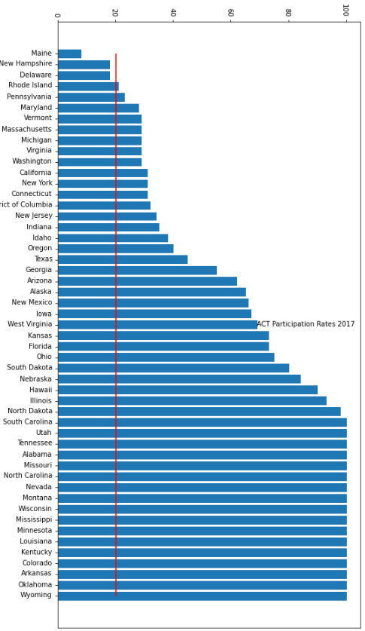
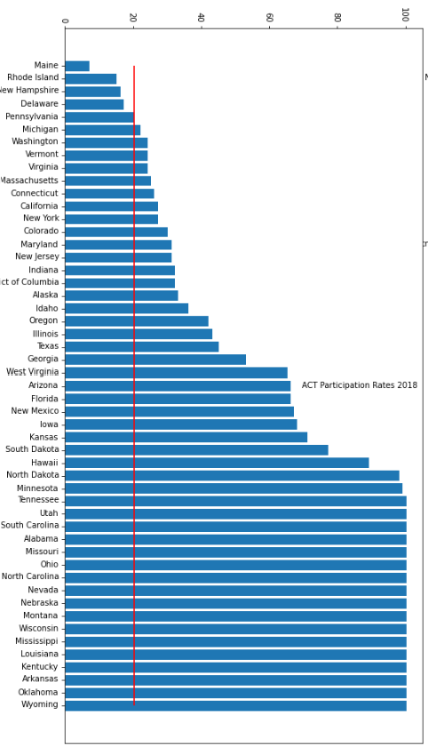
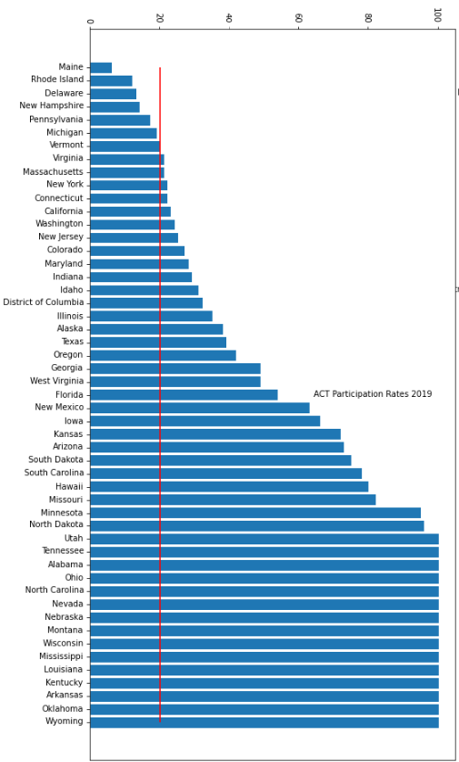
ACT Participation Rates from 2017 to 2019
17
17
15
Notes:
For ACT however, there were only 3, 4, and 6 states that have participation rates lower than 20% in 2017, 2018 and 2019 respectively (we have also excluded these states for further analysis below), but there were 17, 17 and 15 states that have an ACT participation rate of > 99% in 2017, 2018 and 2019 respectively. In contrast, there were only 4,5 and 8 states that have an SAT participation rate of > 99% in 2017, 2018 and 2019 respectively.
Hence we have observed that the ACT test seems to be more popular with lesser states having < 20% participation rates, and more states having close to full 100% participation rate for the 3 years. Was there an reason for it?

Slide 14
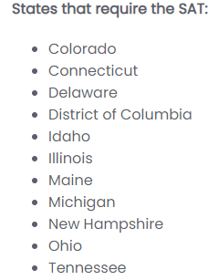
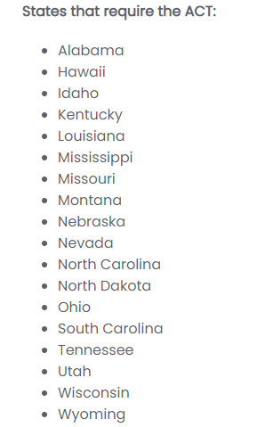
Target states | with potential to improve on either SAT or ACT scores
Certain States have different Graduating criteria.
Participation rate of SAT/ACT is largely influenced by state level education policies.
18 states has requirements for ACT
11 states has requirements for SAT
Inline with the data that seems to show ACT is generally more popular.
source: https://testive.com/state-sat-act/
Notes:
Upon further research, it turns out that more states administer the ACT statewide and in 2018, there were 18 states that require every student to take ACT, compared to just 11 states that require the SAT.
(source : https://testive.com/state-sat-act/)

Slide 15
Target states | with potential to improve on either SAT or ACT scores
We started to plot the average SAT and ACT scores against average GDP, and drilled down into states with
> 20% participation rate
lower than mean SAT and ACT scores,
but with higher than mean GDP,
as states we can target to improve the SAT and ACT results.
NOTE : average is the mean between 2017 to 2019, both years inclusive

Slide 16
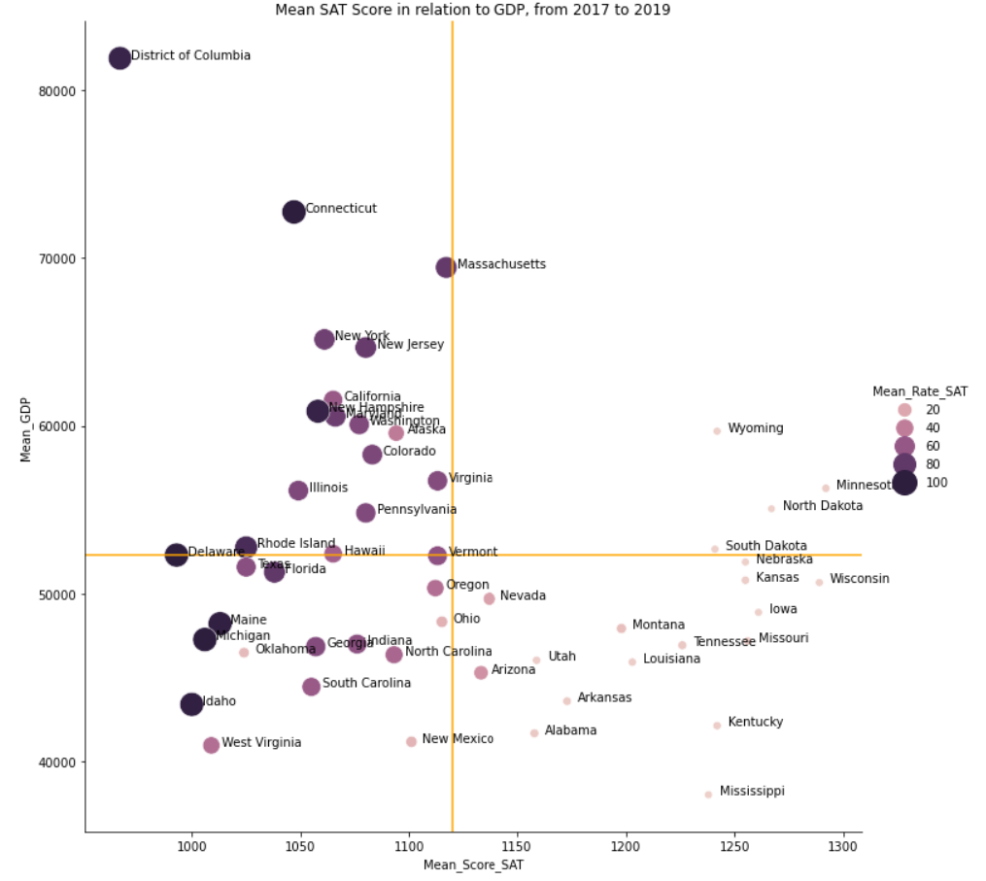
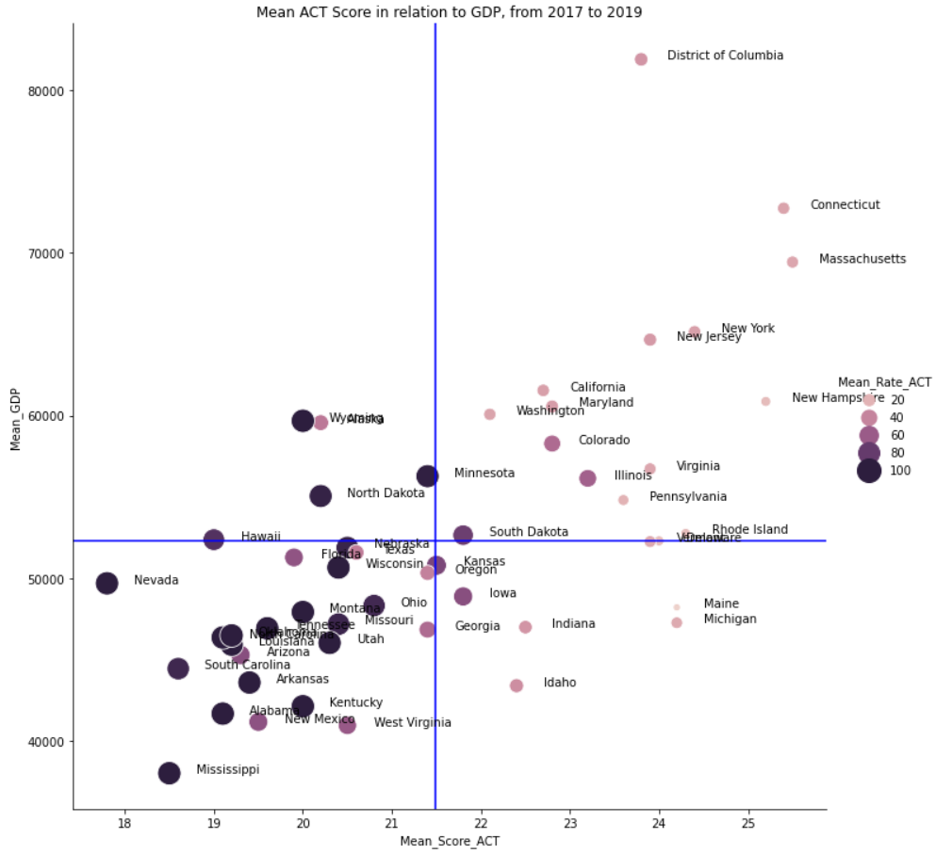
Target states | with potential to improve on either SAT or ACT scores

Slide 17
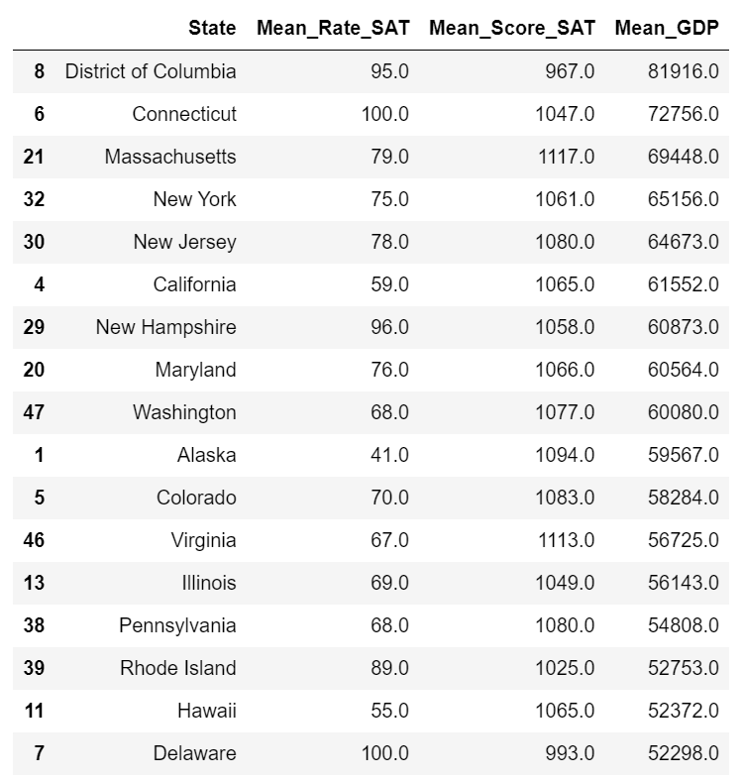
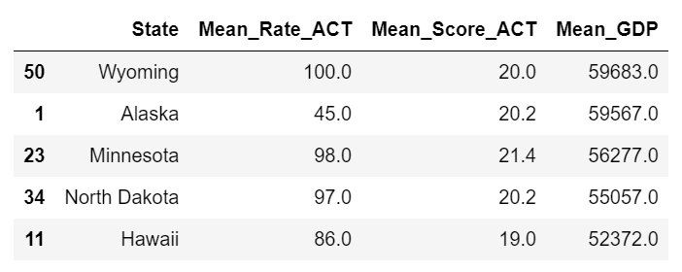
Target states | with potential to improve on either SAT or ACT scores
SAT - 17 States
ACT - 5 States
Filter Criteria :
> 20% participation rate
lower than mean SAT / ACT scores,
above mean GDP

Slide 18
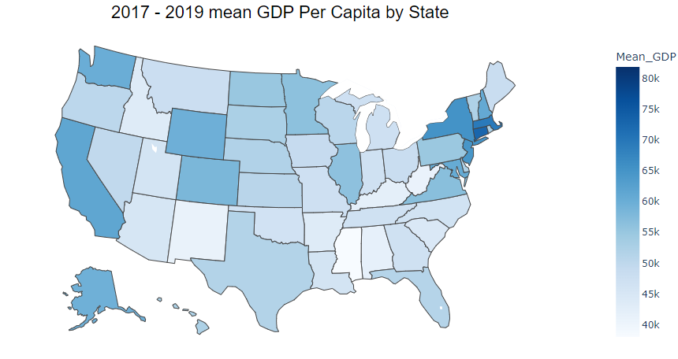
Target states | GDP breakdown
GDPPC Min = 38,006
GDPPC Max = 81,916
GDPPC Mean = 52,275

Slide 19
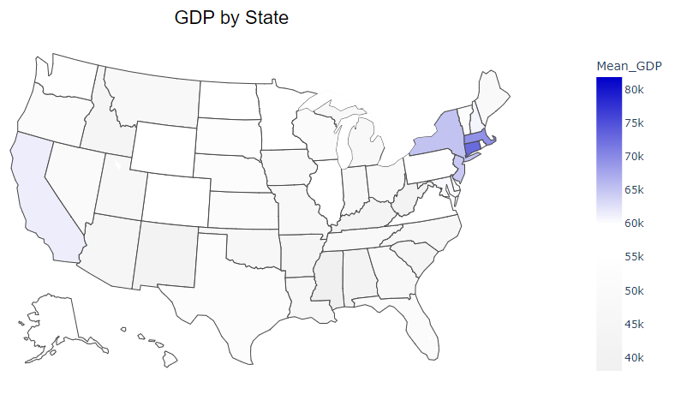
Target states | Top 5 GDP Per Capita
Massachusetts
GDPPC = 69,448
New York
GDPPC = 65,156
Connecticut
GDPPC = 72,756
California
GDPPC = 61,552
New Jersey
GDPPC = 64,673

Slide 20
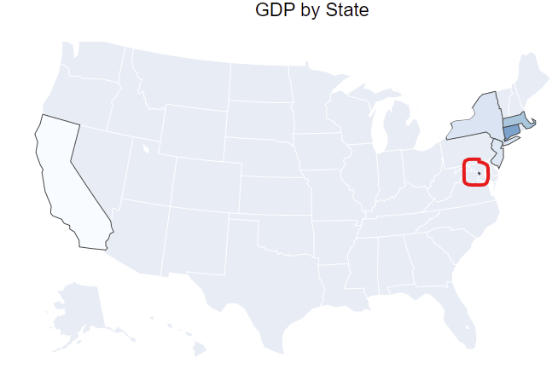
Target states | Top 6 GDP Per Capita
District of Columbia
GDPPC: 81,916
Population:670,050

Slide 21
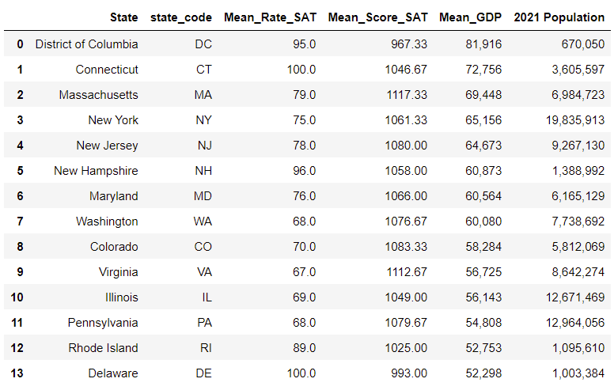
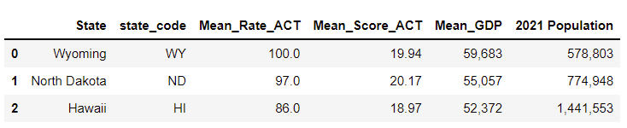
Analysis SAT vs ACT | GDP & Participation rate & Score
SAT - 14 States
ACT - 3 States
There seems to be more opportunities to improve SAT in states with above average GDP
Filter Criteria :
above average mean GDP
at least 65% participation rate
less than average score SAT<1120, ACT<21

Slide 22
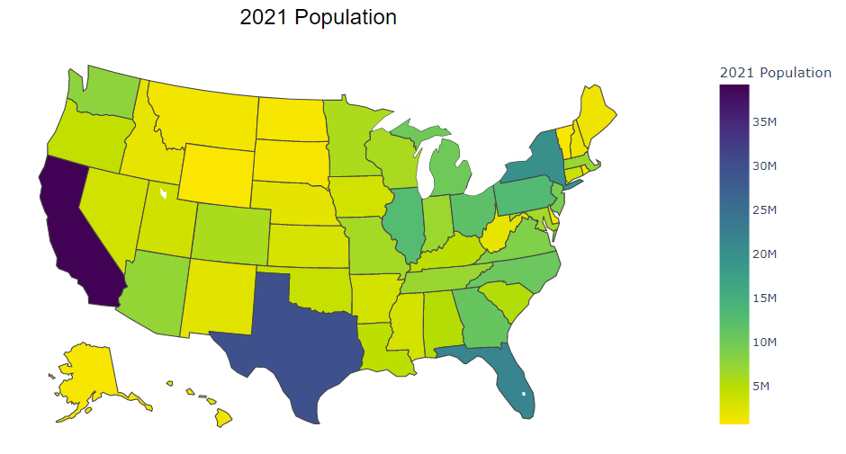
Target states | 2021 Population
Population Min = 578,803 (Wyoming)
Population Max = 39,237,836 (California)
Population Mean = 6,507,720
Note: stats exclusive of states that were dropped

Slide 23
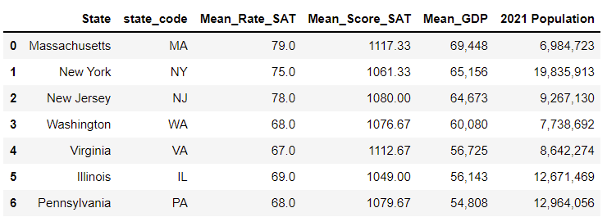
Analysis ACT vs SAT | GDP & Participation rate & Score & GDP
SAT
ACT left with 0 Prospective States
SAT left with 7 Prospective States
Filter Criteria :
Population to be higher than mean 6,507,720.

Slide 24
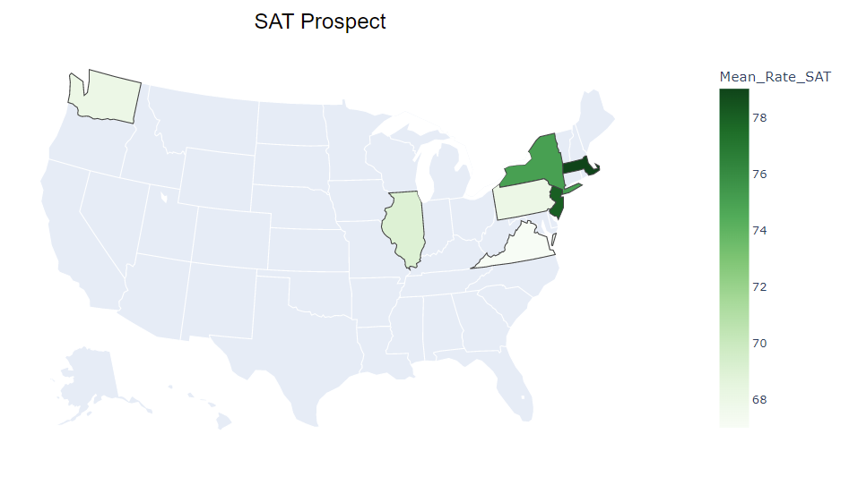
Target states | SAT Prospect

Slide 25

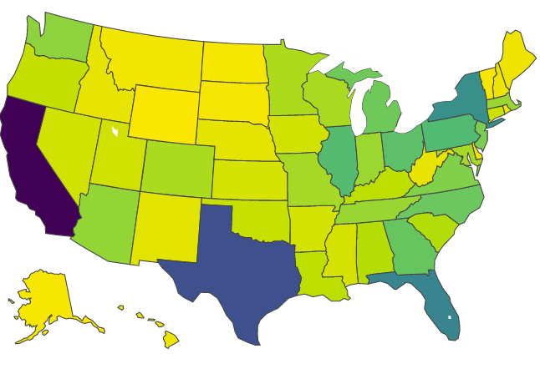
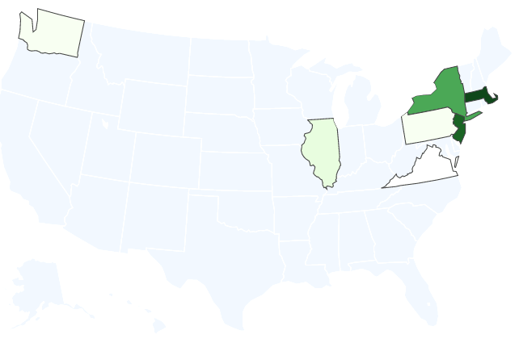
Target states | Summary
2021 Population
GDP
Scores + Participation Rate

Slide 26
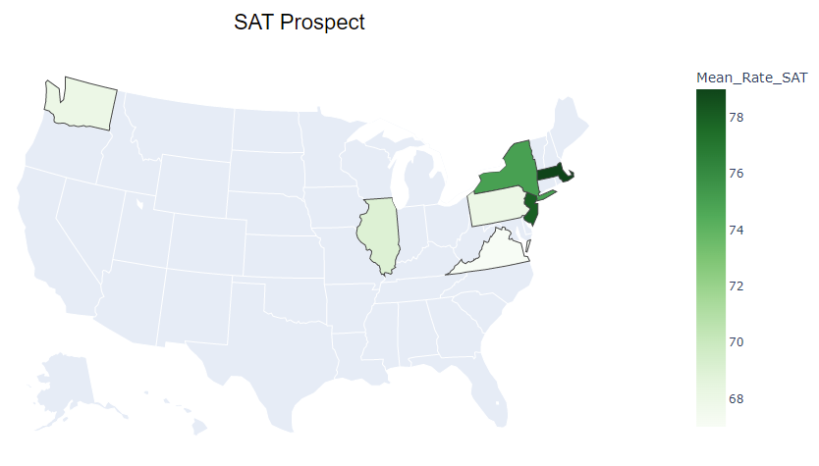
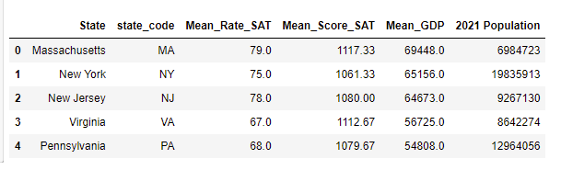
Target states | Summary

Slide 27
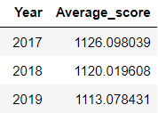
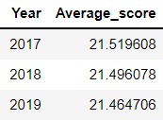
Target states | ACT / SAT Average Scores by Years
SAT Scores
SAT Score: 400~1600
ACT Score: 1~36
Overall decreasing trend in both SAT and ACT Scores
There is room for improvement of the student’s score for both SAT and ACT
ACT Scores

Slide 28
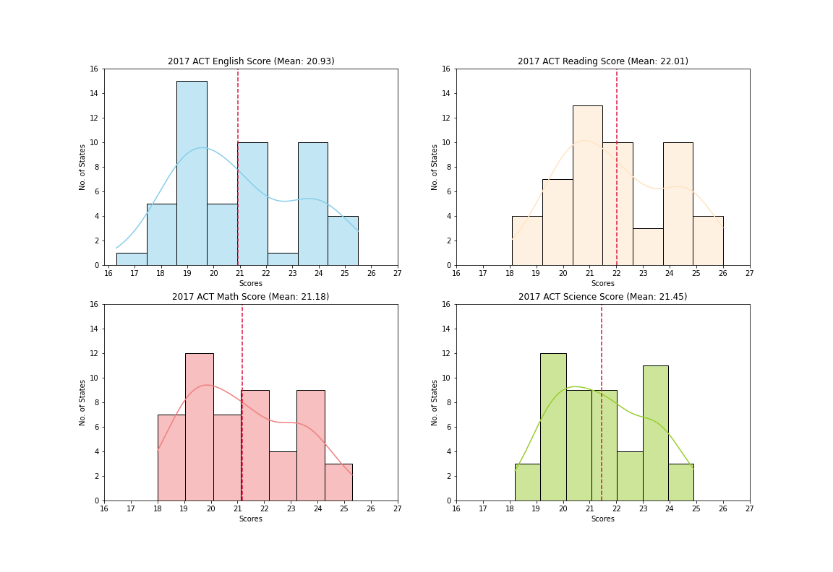
Target states | ACT Subject Scores (2017)

Slide 29
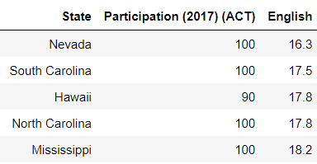
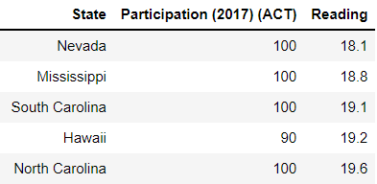
Target states | ACT Subject Scores (2017) - 5 Least Scored States

Slide 30
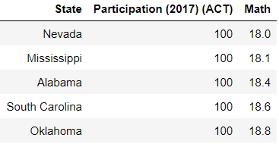
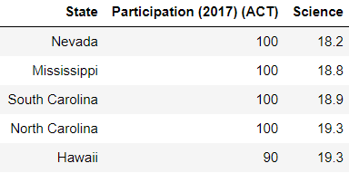
Target states | ACT Subject Scores (2017) - 5 Least Scored States

Slide 31
Target states | ACT Subject Scores - Summary
ACT:
Students generally score lower for English subject compared to other subjects
Nevada State has been scoring the lowest for all 4 subjects - not accurate due to its location
Nevada, Mississippi and South Carolina States have appeared in the top 5 least scored States for all subjects

Slide 32
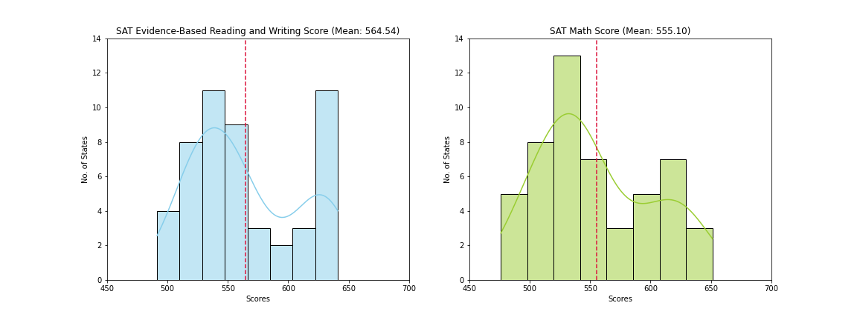
Target states | SAT Subject Scores - 5 Least Scored States

Slide 33
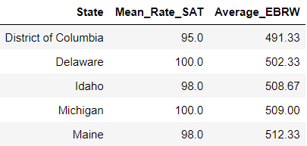
Target states | SAT Subject Scores - 5 Least Scored States

Slide 34
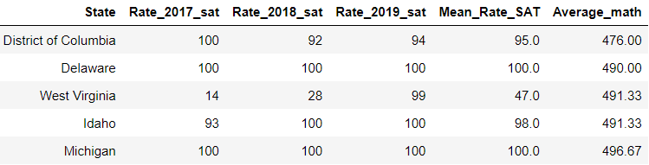
Target states | SAT Subject Scores - 5 Least Scored States

Slide 35
Target states | SAT Subject Scores - Summary
SAT:
Students generally score better for EBRW than Math
District of Columbia has scored the least for both EBRW and Math
West Virginia’s scores might not be accurate as the participation rate in 2017/18 are low
District of Columbia, Delaware, Idaho and Michigan in the top 5 least scored States for both subjects

Slide 36
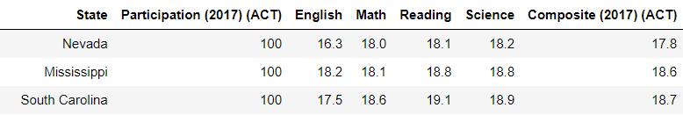
Target states | Final Conclusion
SAT:
ACT (only based on scores):

Slide 37

Appendix
Additional Data that will further enhance our analysis
Population density
Age distribution
Government Spending on education
Test suitability based on students capability (i.e. ACT has a science component which SAT doesn’t have)
SWOT Analysis

